Slide 1
Impacts on CMAQ Peak Ozone Predictions from using Different BEIS Biogenic Emissions Options
April 22, 2019

Slide 2
This study is looking into
The impact on CMAQ peak ozone predictions from using BELD water fix vs using the original BELD
The impact on CMAQ peak ozone predictions from using inline BEIS biogenic emissions vs offline BEIS biogenic emissions

Slide 3
CMAQ version 5.2.1
2016 beta emissions (2016ff) for anthropogenic surface 2D emissions and 8 inline point sources emissions
Four CMAQ simulations were conducted for the period of May to August 2016:
Inline BEIS with original BELD
Inline BEIS with BELD water fix
Offline BEIS with original BELD
Offline BEIS with BELD water fix

Slide 4
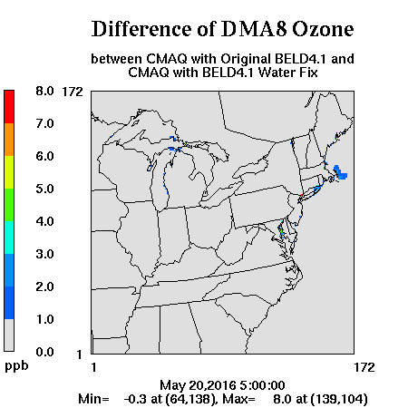
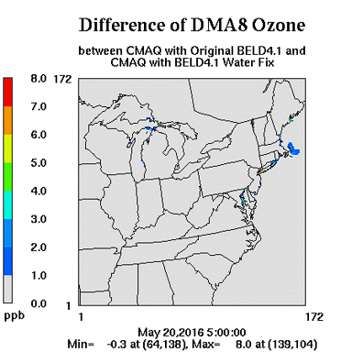

Slide 5
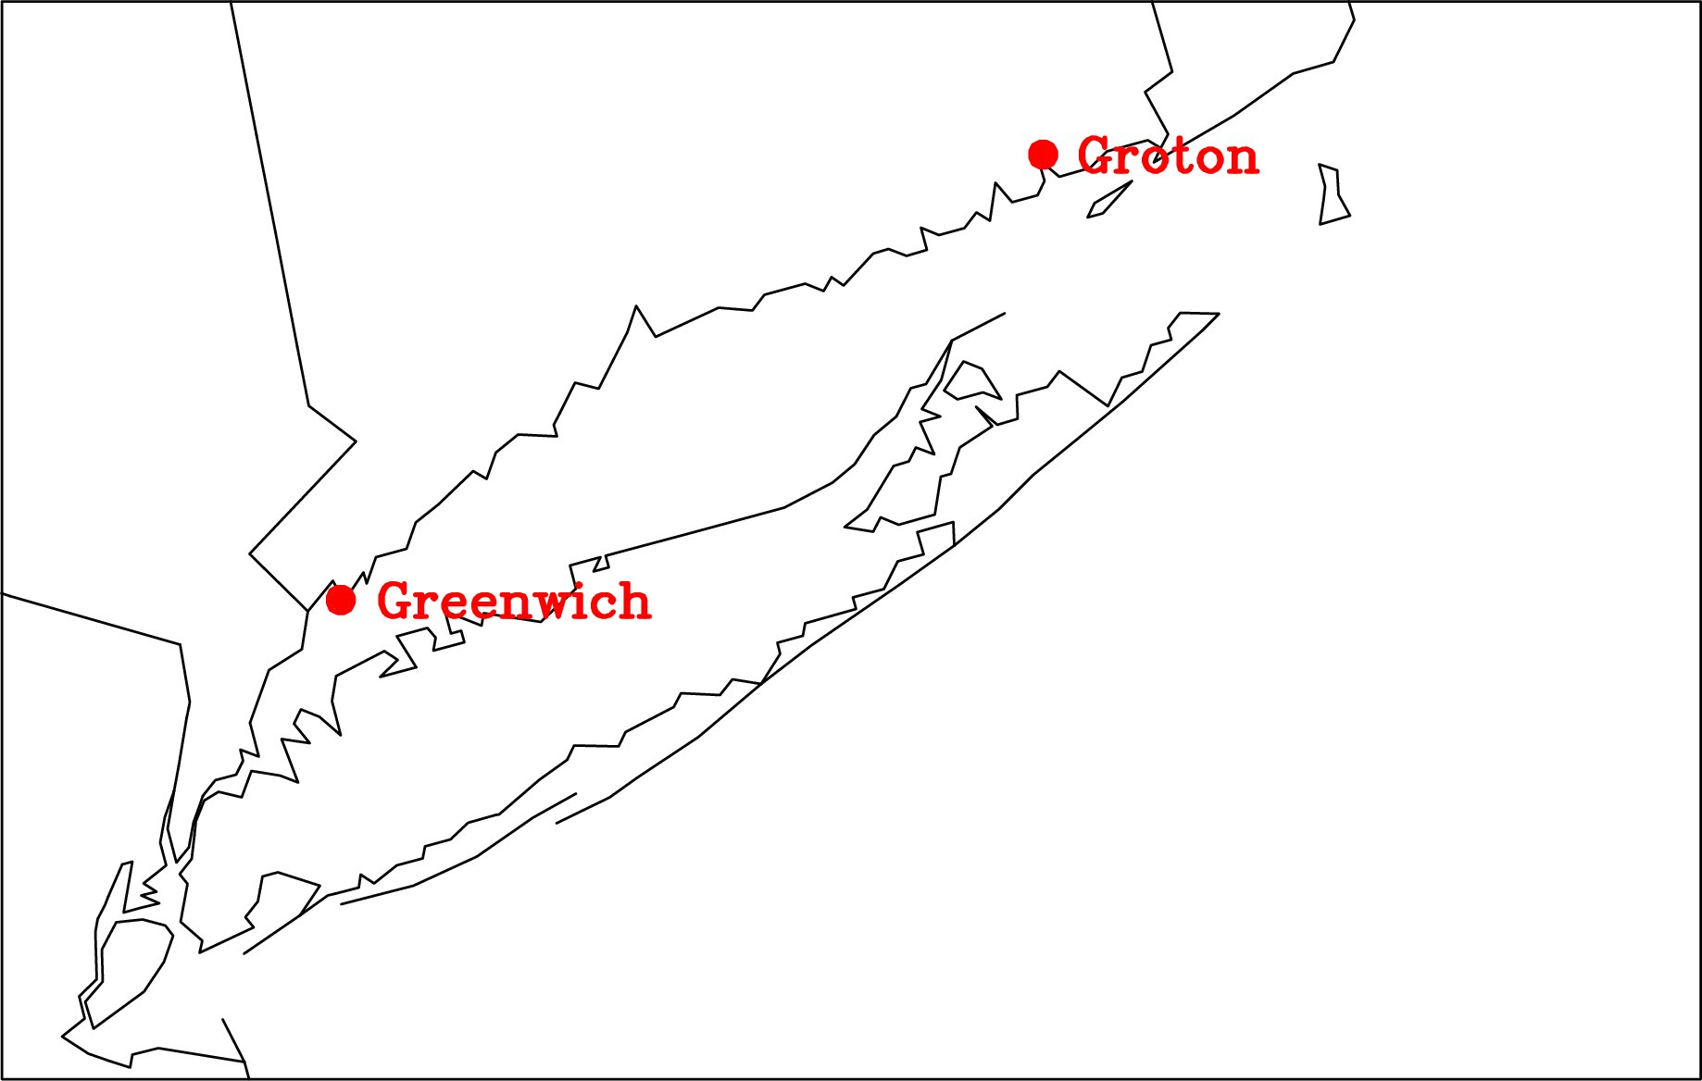

Slide 7
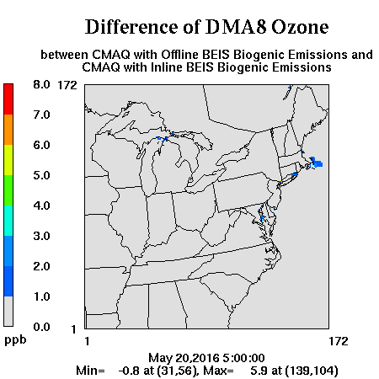
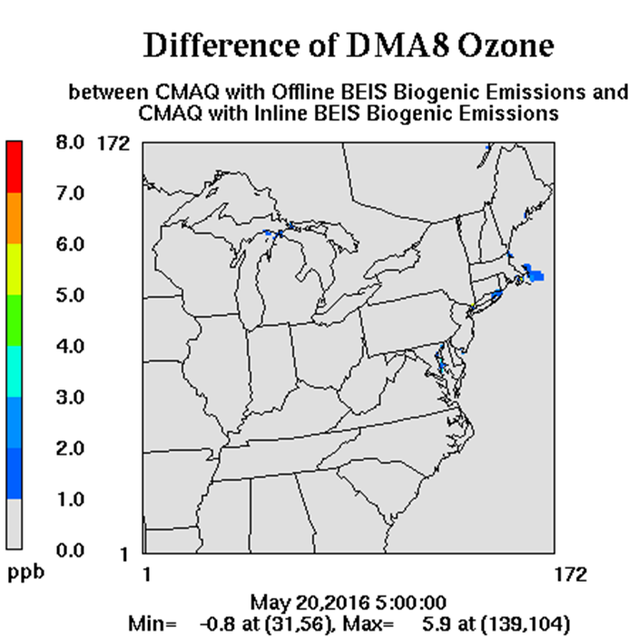

Slide 8
CMAQ4 Offline BEIS with BELD water fix
CMAQ2 Inline BEIS with BELD water fix
Two runs are with identical GSPRO (B10C6) and B3GRD files

Slide 9
Summary
CMAQ using BEIS biogenic emissions with BELD water fix can have nontrivial (30+ ppb) DMA8 ozone reductions, especially over Long Island Sound and along northeast shoreline.
CMAQ using offline BEIS biogenic emissions tends to have higher DMA8 ozone over water, compared to using inline BEIS biogenic emissions.

